Slide 1

Designing interactive visualizations in Power BI

Slide 2
Visualizations in Power BI
Power BI’s visualization tools are designed to turn complex datasets into easily understandable, interactive graphics that reveal trends, patterns, and insights. It offers a broad selection of visuals, including bar and column charts for categorical comparisons, line and area charts for tracking trends over time, and pie or donut charts for illustrating proportions.. The platform’s flexibility empowers users to create visually appealing, data-rich dashboards that support strategic decision-making and enhance data storytelling.

Slide 3
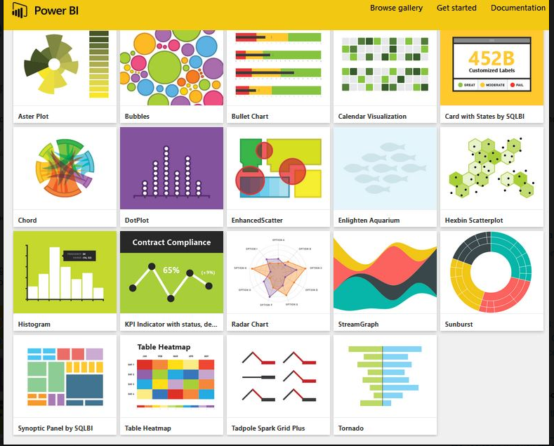
Types of Visualizations in Power BI
Bar and Column Charts
Line Charts
Pie and Donut Charts
Area Charts
Tables and Matrices
Maps (Choropleth and Filled)
Tree Maps
Funnel Charts
Gauge and KPI Visuals
Cards (Single Number and Multi-Row)
Waterfall Chart

Slide 4
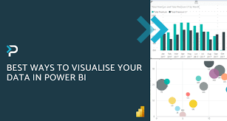
key steps and tips to design effective interactive visualizations in Power BI
1. Choose the Right Visualization Type
Select visuals that best represent your data, like bar charts for categorical data, line charts for trends, or maps for geographical data.
Use custom visuals from Power BI's marketplace if the standard options don’t meet your needs.

Slide 5

2. Use Filters and Slicers
Slicers allow users to filter data by categories like dates, regions, or product categories. These can be dropdowns or lists to make filtering easier.
Use visual-level, page-level, or report-level filters to control data views and scope.
Implement drill-through filters to enable users to click and access more detailed data.

Slide 6
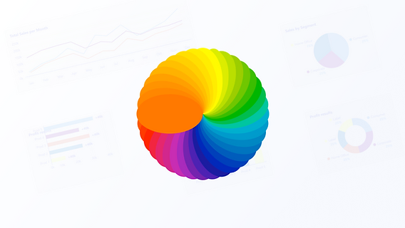
3. Enable Cross-Filtering and Cross-Highlighting
Cross-filtering allows selecting an item in one visualization (like a bar in a bar chart) to filter other visuals on the page automatically.
This technique creates a seamless experience for users to explore relationships and patterns in data interactively.

Slide 7

4. Create Drill-Down and Drill-Up Options
Hierarchical data (like regions and cities) can benefit from drill-down capabilities. You can set hierarchies in visuals to let users explore deeper levels of data.
Enable the drill-up option to allow users to return to higher levels after drilling down

Slide 8
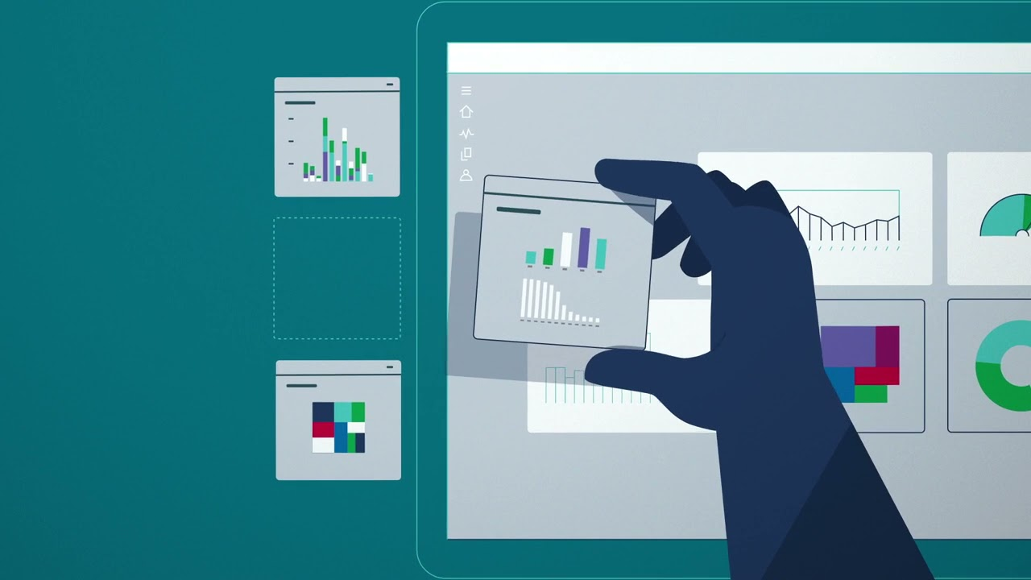
5. Add Bookmarks for Custom Views
Bookmarks save specific views of your report. By creating multiple bookmarks, you can showcase different insights or states of data.
Use bookmarks with buttons to switch between views, allowing a more narrative-driven experience.

Slide 9

6. Leverage Tooltips for Extra Information
Enable tooltips to show additional data when users hover over a data point.
Custom tooltips can be created by adding visualizations, making them useful for showing supporting metrics or explanations

Slide 10

7. Use Buttons and Navigation for Guided Interaction
Buttons can be used to navigate between report pages, reset filters, or trigger bookmarks. Adding icons and labels to buttons enhances usability.
Page navigation buttons are useful for creating a story or report flow, helping guide users through the data logically.

Slide 11

8. Incorporate Q&A for Natural Language Queries
Power BI’s Q&A feature allows users to type questions in natural language to get specific answers. Train this feature with relevant terms to improve accuracy.
This can be useful for ad hoc exploration, making it easier for non-technical users to engage with the data.

Slide 12
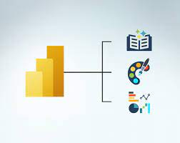
9. Optimize Performance for Interactivity
Minimize data loads, optimize data models, and use data aggregations to ensure reports load quickly and interactions are seamless.
Limit the number of visuals on each page to avoid performance slowdowns and keep the design user-friendly.

Slide 13

10. Test Usability and Refine
Test the interactivity to ensure users understand how to interact with visuals and navigation
Collect feedback to refine filters, drill-throughs, and other interactive elements based on user needs.

Slide 14
Conclusion
In conclusion, designing interactive visualizations in Power BI allows users to explore and analyze data dynamically, making insights more accessible and actionable. By leveraging various tools like slicers, drill-throughs, cross-filtering, and bookmarks, you can create an engaging, user-friendly experience that empowers users to delve deeper into data.

Slide 15


Thank you
ajaycraju98@gmail.com

